Slide 1

Safeguarding training and support for VCS
550+
2,000+
40,000+
charities, clubs, groups
employees
volunteers
Increasing demand, complexity and scrutiny

Slide 2
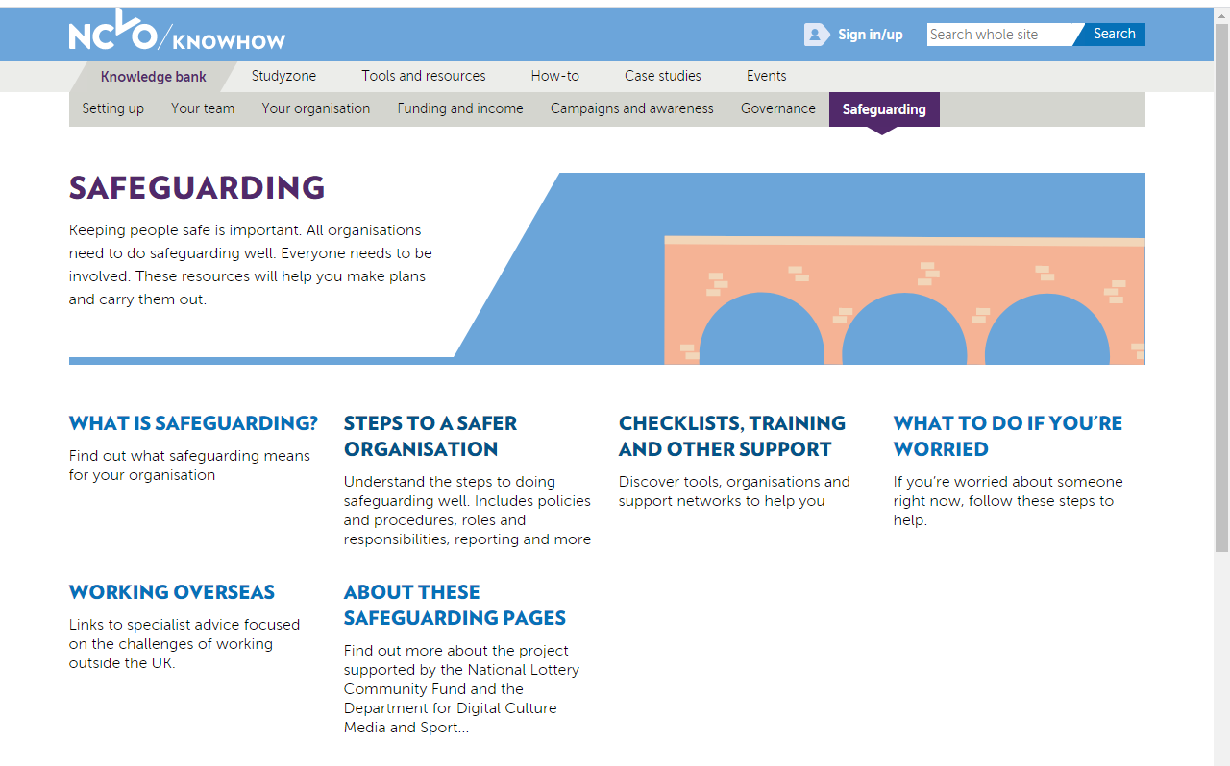
Safeguarding training and support for VCS
NCVO website

Slide 3

Safeguarding training and support for VCS
Safer Culture North East

Slide 4

Safeguarding training and support for VCS
VODA
Notes:
ion

Slide 5
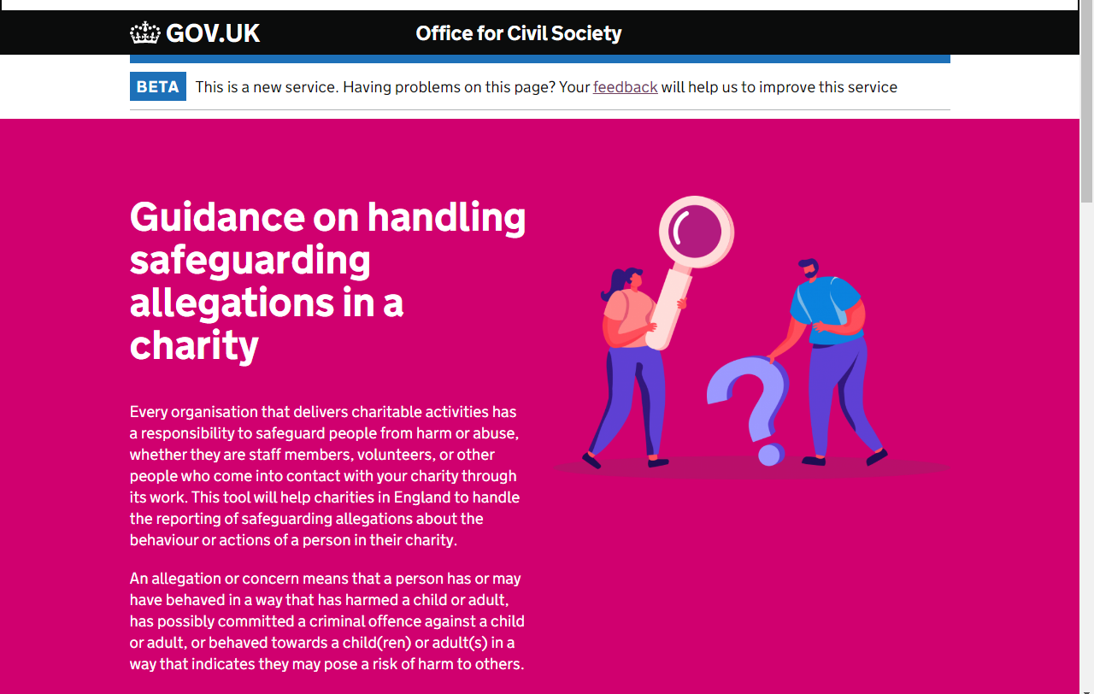
Safeguarding training and support for VCS
GOV.UK

